Slide 1


<Name>
<Date>

Slide 2

Outline
Executive Summary
Introduction
Methodology
Results
Conclusion
Appendix

Slide 3
Executive Summary
Summary of methodologies
Data Collection through API
Data Collection with Web Scraping
Data Wrangling
Exploratory Data Analysis with SQL
Exploratory Data Analysis with Data Visualization
Interactive Visual Analytics with Folium
Machine Learning Prediction
Summary of all results
Exploratory Data Analysis result
Interactive analytics in screenshots
Predictive Analytics result

Slide 4
Introduction
Project background and context
SpaceX markets Falcon 9 rocket launches on its website at a price of $62 million, which is considerably less than the cost of other providers, whose prices start at $165 million per launch. The primary reason for this cost savings is SpaceX's ability to reuse the first stage of the rocket. As a result, predicting whether the first stage will successfully land can help determine the cost of a launch. This information could be beneficial for other companies that want to compete with SpaceX for a rocket launch contract. Therefore, the objective of this project is to develop a machine-learning pipeline that can accurately forecast whether the first stage of a Falcon 9 rocket will land successfully.
Problems you want to find answers
Successfull landing of rockets dependent to which factors?
The relationship between various features that determine the success rate of a successful landing.
Which operating conditions are essential to ensure a successful landing program?

Slide 5

Section 1

Slide 6
Methodology
Executive Summary
Data collection methodology:
Data was collected using SpaceX API and web scraping from Wikipedia.
Perform data wrangling
One-hot encoding was applied to categorical features to assign numerical values.
Perform exploratory data analysis (EDA) using visualization and SQL
Perform interactive visual analytics using Folium and Plotly Dash
Perform predictive analysis using classification models
How to build, tune, evaluate classification models

Slide 7
Data Collection
The data was collected using various methods
Data collection was done using get request to the SpaceX API.
Next, the response was decoded content as a Json using .json() function call and turn it into a pandas dataframe using .json_normalize().
Cleaning of the data, inspecting the missing values has been performed and, filling in the missing values are done where it was necessary.
In addition, we performed web scraping from Wikipedia for Falcon 9 launch records with BeautifulSoup.
The objective was to extract the launch records as HTML table, parse the table and convert it to a pandas dataframe for future analysis.

Slide 8
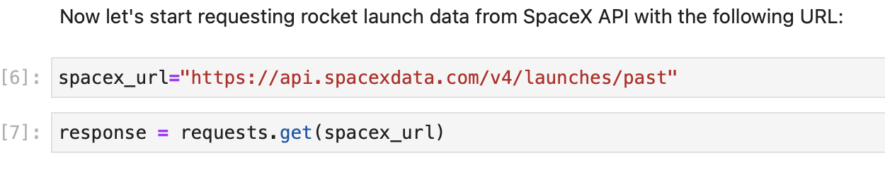
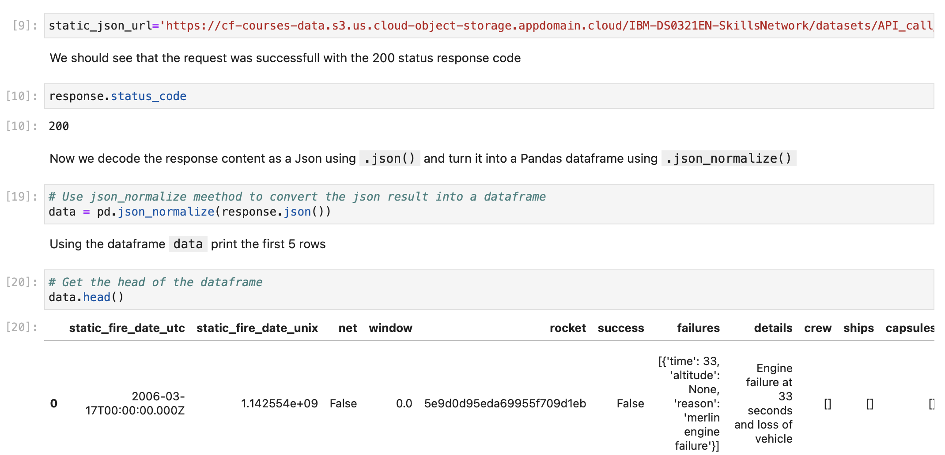
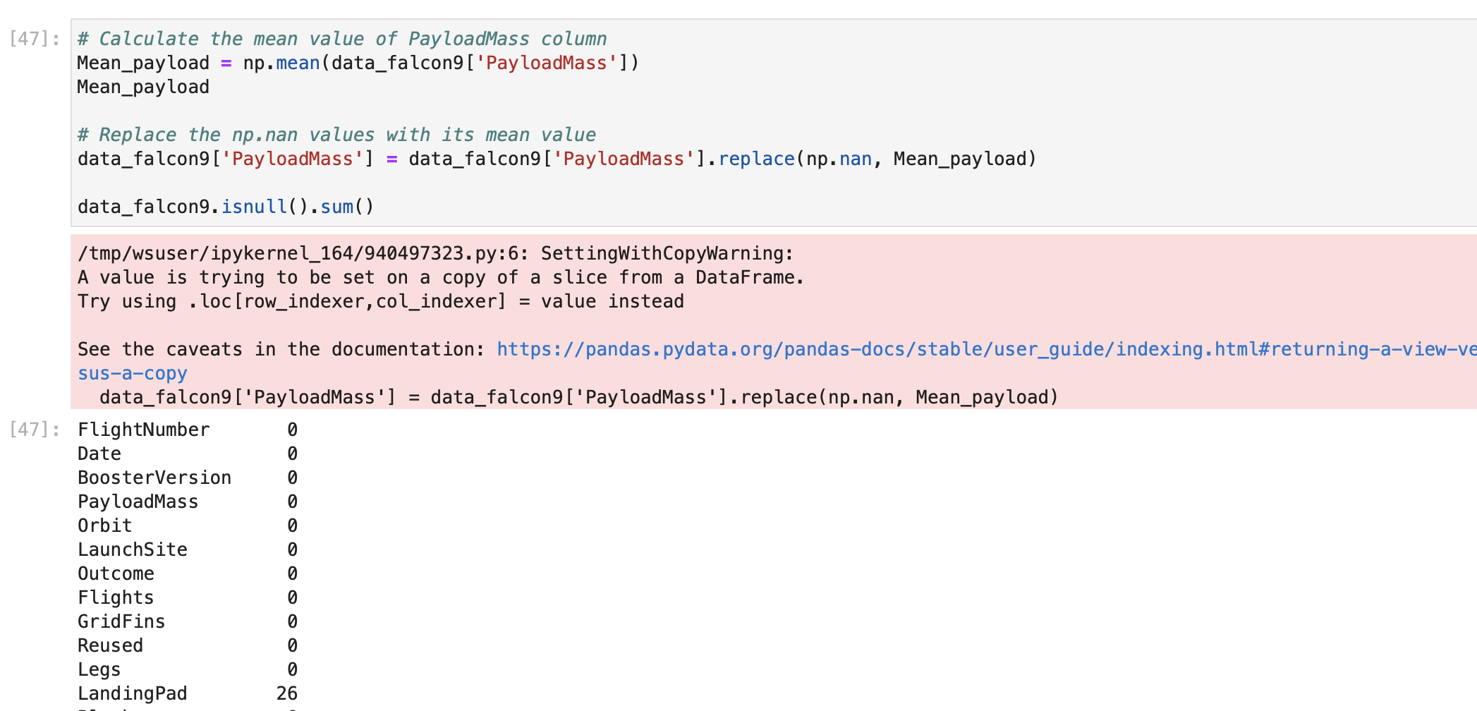
Data Collection – SpaceX API
Place your flowchart of SpaceX API calls here
We used the get request to the SpaceX API to collect data, clean the requested data and did some basic data wrangling and formatting.
The link to the notebook is: https://github.com/Debojyoti91/IBM_data_analytics_capston_final_projects/blob/main/notebooks/jupyter-labs-spacex-data-collection-api-final.ipynb

Slide 9
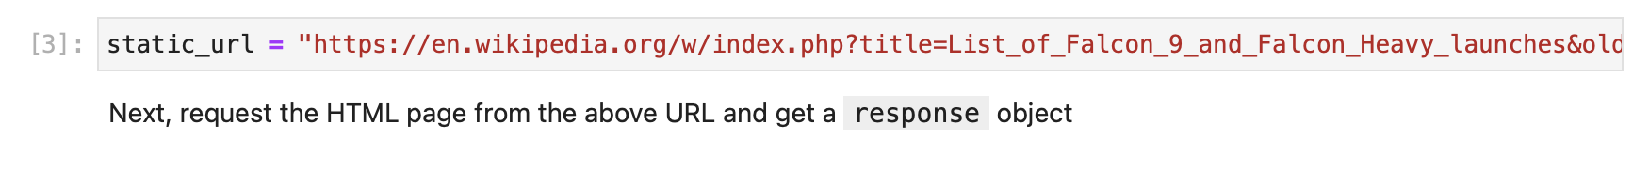
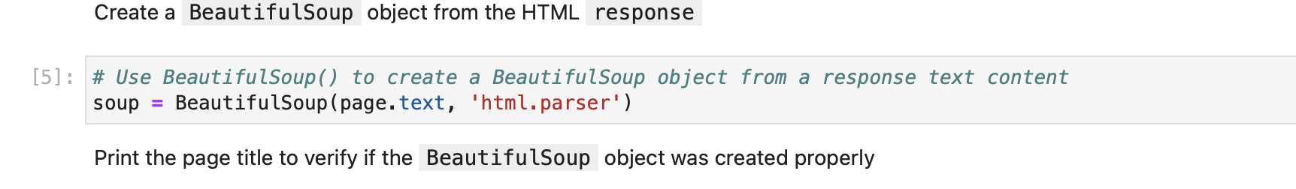
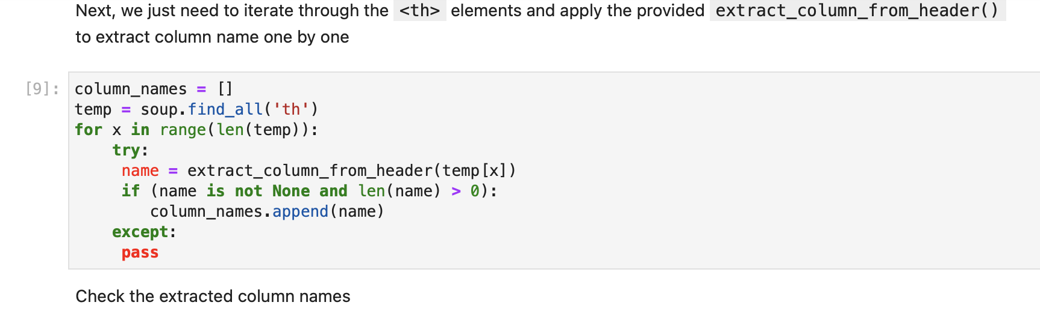
Data Collection - Scraping
web scrapping is applied to obtain Falcon 9 launch dataset with BeautifulSoup
Results are parsed to the table and converted it into a pandas dataframe.
The link to the notebook is:
https://github.com/Debojyoti91/IBM_data_analytics_capston_final_projects/blob/main/notebooks/spacex-webscraping.ipynb
Place your flowchart of web scraping here

Slide 10
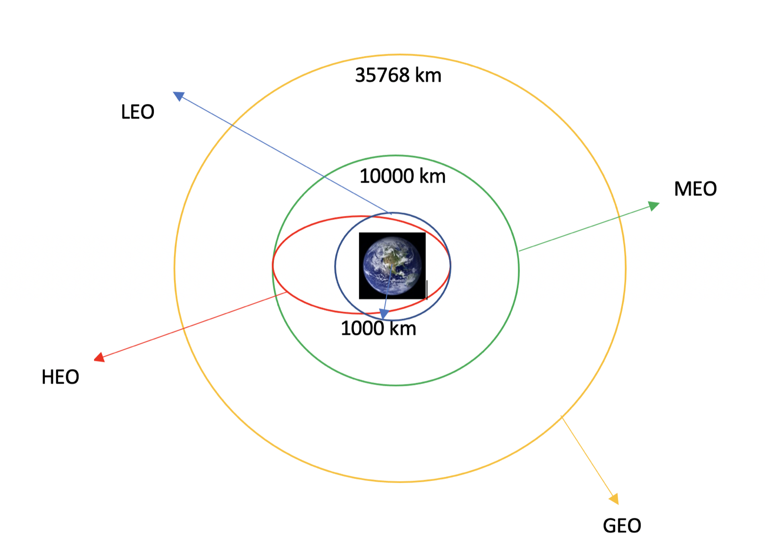
Data Wrangling
Exploratory data analysis have been performed and the training labels also been assigned.
The number of launches at each site, and the number and occurrence of each orbits have been calculated.
The landing outcome labels from outcome column have been calculated and the data frame have been exported as results to csv.
The link to the notebook is https://github.com/Debojyoti91/IBM_data_analytics_capston_final_projects/blob/main/notebooks/labs-jupyter-spacex-Data_wrangling-final.ipynb

Slide 11
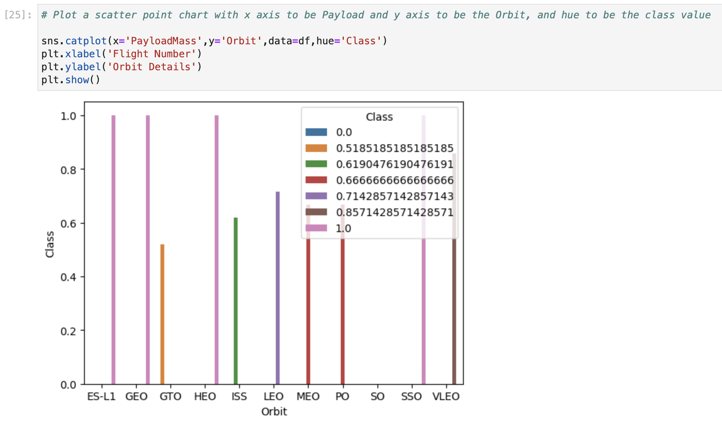
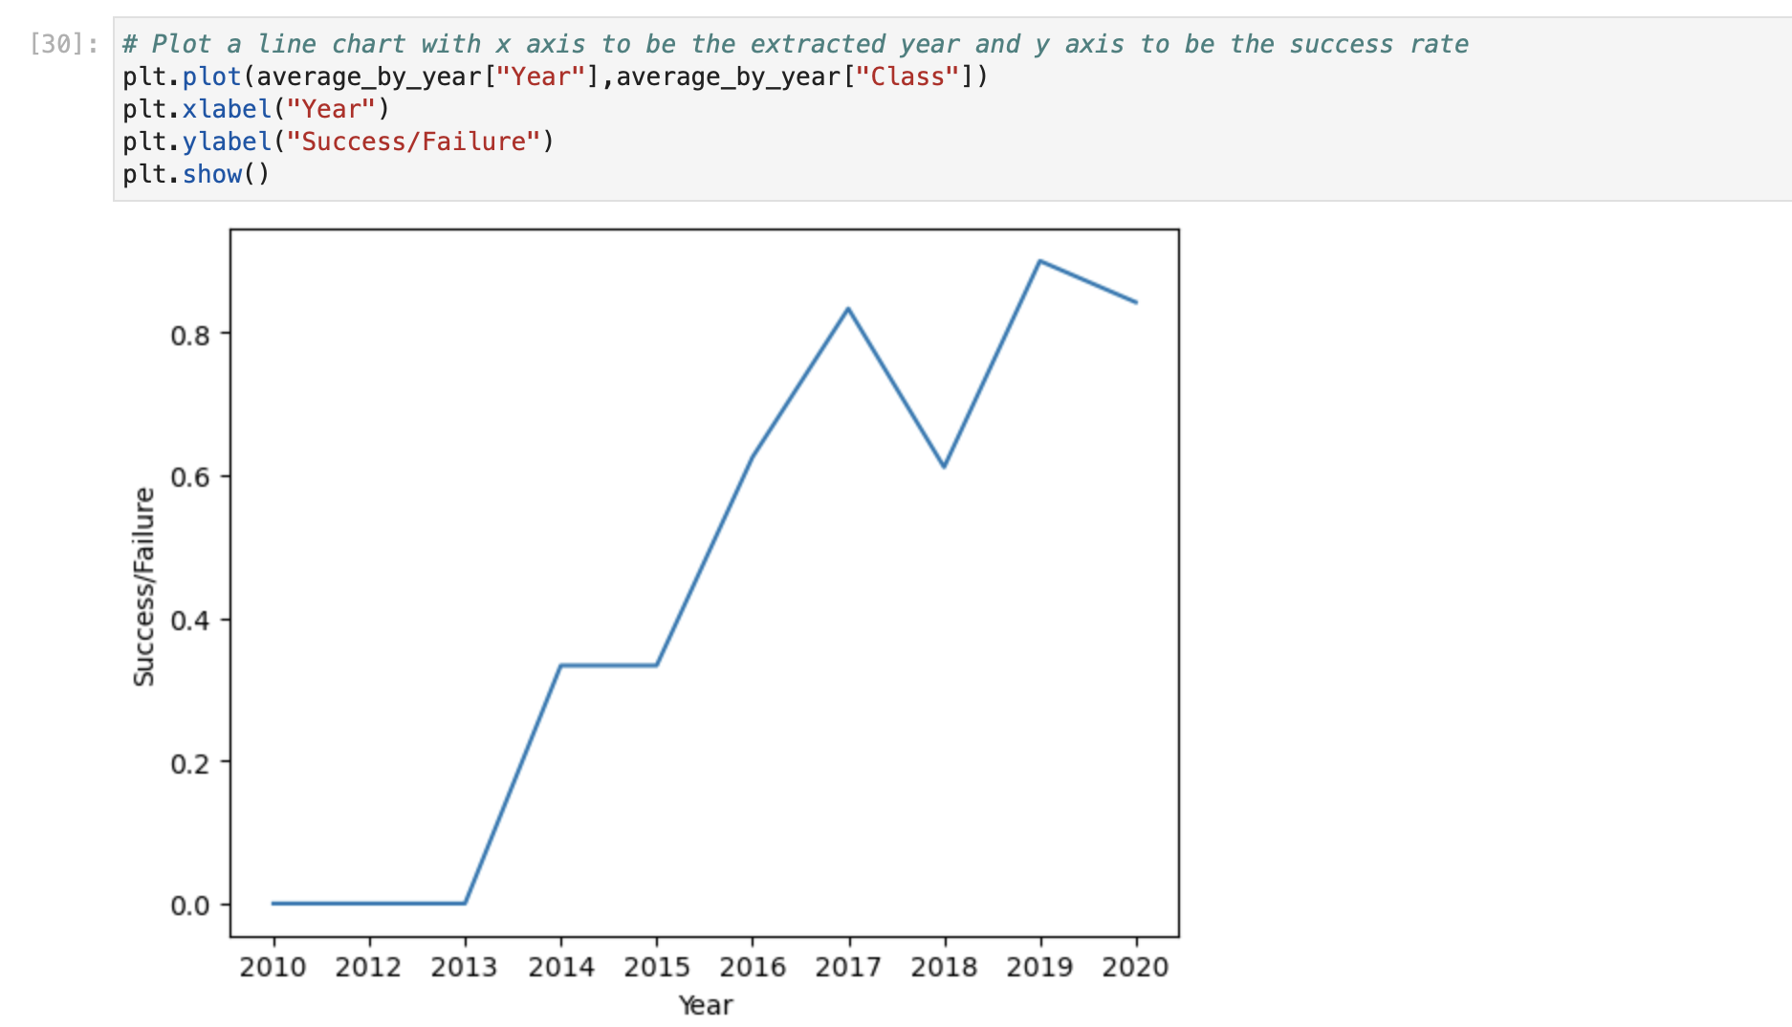
EDA with Data Visualization
We explored the data by visualizing the relationship between flight number and launch Site, payload and launch site, success rate of each orbit type, flight number and orbit type, the launch success yearly trend.
The link to the notebook is: https://github.com/Debojyoti91/IBM_data_analytics_capston_final_projects/blob/main/notebooks/jupyter-labs-eda-dataviz-final.ipynb

Slide 12
EDA with SQL
SpaceX dataset loaded into a PostgreSQL database without leaving the jupyter notebook.
EDA with SQL has been performed to get insight from the data and, the queries have been called to find out the instances:
The names of unique launch sites in the space mission.
The total payload mass carried by boosters launched by NASA (CRS)
The average payload mass carried by booster version F9 v1.1
The total number of successful and failure mission outcomes
The failed landing outcomes in drone ship, their booster version and launch site names.
The link to the notebook is: https://github.com/Debojyoti91/IBM_data_analytics_capston_final_projects/blob/main/notebooks/jupyter-labs-eda-sql-coursera-final.ipynb

Slide 13
Build an Interactive Map with Folium
Marked all launch sites, and added map objects such as markers, circles, lines to mark the success or failure of launches for each site on the folium map.
Assigned the feature launch outcomes (failure or success) to class 0 and 1.i.e., 0 for failure, and 1 for success.
Using the color-labeled marker clusters, we identified which launch sites have relatively high success rate.
Calculated the distances between a launch site to its proximities. We answered some question for instance:
Are launch sites near railways, highways and coastlines.
Do launch sites keep certain distance away from cities.
The link of the notebook: https://github.com/Debojyoti91/IBM_data_analytics_capston_final_projects/blob/main/notebooks/lab_jupyter_launch_site_location-final.ipynb

Slide 14
Build a Dashboard with Plotly Dash
Using Plotly dash, we created an interactive dashboard.
We created pie graphs that display all of the launches made by particular sites.
For each booster version, we created a scatter graph to highlight the relationship between the outcome and the payload mass (Kg).
The link to the notebook is: https://github.com/Debojyoti91/IBM_data_analytics_capston_final_projects/blob/main/notebooks/plotly_app.py

Slide 15
Predictive Analysis (Classification)
Using Numpy and Pandas, we loaded the data, transformed it, and divided it into training and testing sets.
Using GridSearchCV, we constructed various machine learning models and tuned various hyperparameters.
Our model was measured by accuracy, and it was enhanced through feature engineering and algorithm tweaking.
The most effective classification model was discovered.
The link to the notebook is: https://github.com/Debojyoti91/IBM_data_analytics_capston_final_projects/blob/main/notebooks/SpaceX_Machine_Learning_Prediction_Part_5-final.ipynb

Slide 16

Results
From EDA it can be concluded that The larger the flight amount at a launch site, the greater the success rate at a launch site. Also, Launch success rate started to increase in 2013 till 2020.
KSC LC-39A has the highest success rate.
From interactive session, the conclusion can be drawn that the Orbits ES-L1, GEO, HEO, SSO, VLEO had the most success rate.
From the predictive analysis it can be seen the classification model, DecisionTree has the highest success rate of 87.3%.

Slide 17

Section 2

Slide 18

Flight Number vs. Launch Site
Show a scatter plot of Flight Number vs. Launch Site
Show the screenshot of the
The plot led us to the conclusion that a launch site's success rate increases with the size of the flight quantity.

Slide 19

Payload vs. Launch Site
Show a scatter plot of Payload vs. Launch Site
Show the screenshot of the scatter plot with explanations
It can be concluded that higher the payload mass of the launchsite CCAFS SLC 40, greater is the success probability of the rocket.

Slide 20

Success Rate vs. Orbit Type
Show a bar chart for the success rate of each orbit type
Show the screenshot of the scatter plot with explanations
From the plot, we can see that ES-L1, GEO, HEO, SSO, VLEO had the most success rate.

Slide 21

Flight Number vs. Orbit Type
Show a scatter point of Flight number vs. Orbit type
Show the screenshot of the scatter plot with explanations
The plot of the Flight Number versus Orbit type is shown below. We note that success in the LEO orbit is correlated with the number of flights, however there is no correlation between the number of flights and the GTO orbit.

Slide 22


Payload vs. Orbit Type
We can see that successful landings with heavier payloads tend to occur more frequently in PO, LEO, and ISS orbits.

Slide 23

Launch Success Yearly Trend
Show a line chart of yearly average success rate
The plot reveals that the success rate has been rising since 2013 and will continue to do so until 2020.

Slide 24

All Launch Site Names
Find the names of the unique launch sites
To display just distinct launch sites from the SpaceX data, we utilized the keyword DISTINCT.

Slide 25

Launch Site Names Begin with 'CCA'
Find 5 records where launch sites begin with `CCA`
We performed the aforementioned query to show 5 records for launch sites that start with "CCA."

Slide 26

Total Payload Mass
Calculate the total payload carried by boosters from NASA
It is determined that NASA's boosters carried 45596 pounds of payload in total.

Slide 27

Average Payload Mass by F9 v1.1
Calculate the average payload mass carried by booster version F9 v1.1
The average mass of the payload that booster version F9 v1.1 can carry was calculated to be 2928.4.

Slide 28

First Successful Ground Landing Date
Find the dates of the first successful landing outcome on ground pad
It is to be noted that the first successful landing result on the ground pad occurred on December 22, 2015.

Slide 29

Successful Drone Ship Landing with Payload between 4000 and 6000
In order to find boosters that have successfully landed on drone ships, we employed the WHERE clause. We then used the AND condition to identify successful landings with payload masses larger than 4,000 but less than 6,000.

Slide 30

Total Number of Successful and Failure Mission Outcomes
Calculate the total number of successful and failure mission outcomes
To filter for WHERE MissionOutcome was a success or failure, we used wildcards like '%'.

Slide 31

Boosters Carried Maximum Payload
Using the MAX() function and a subquery in the WHERE clause, we were able to identify the booster that had carried the most payload.

Slide 32

2015 Launch Records
List the failed landing_outcomes in drone ship, their booster versions, and launch site names for in year 2015
In order to filter for failure landing outcomes in drone ship, their booster versions, and launch site names for the year 2015, we employed permutations of the WHERE clause, LIKE, AND, and BETWEEN conditions.

Slide 33

Rank Landing Outcomes Between 2010-06-04 and 2017-03-20
In order to filter for landing outcomes BETWEEN 2010-06-04 and 2010-03-20, we choose Landing outcomes and the COUNT of landing outcomes from the data.
The landing results were categorized using the GROUP BY clause, and they were then put in decreasing order using the ORDER BY clause.

Slide 34

Section 3

Slide 35
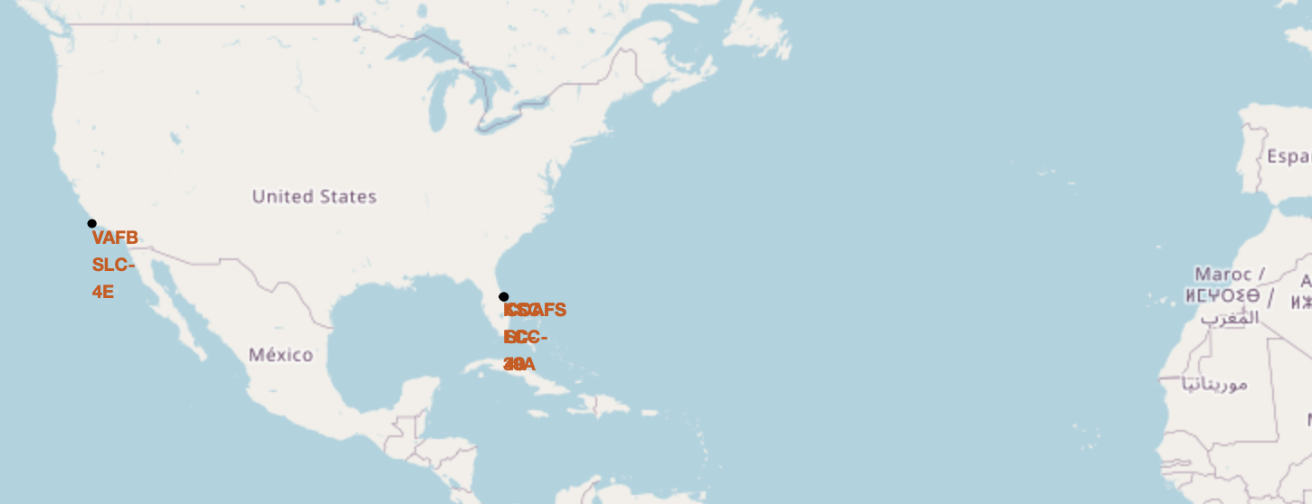
All Launching Site Map Markers in USA
Replace <Folium map screenshot 1> title with an appropriate title
Explore the generated folium map and make a proper screenshot to include all launch sites’ location markers on a global map
In this plot, all the SpaceX launching site maps are displayed, and these are located around the eastern and western costal part of USA.

Slide 36
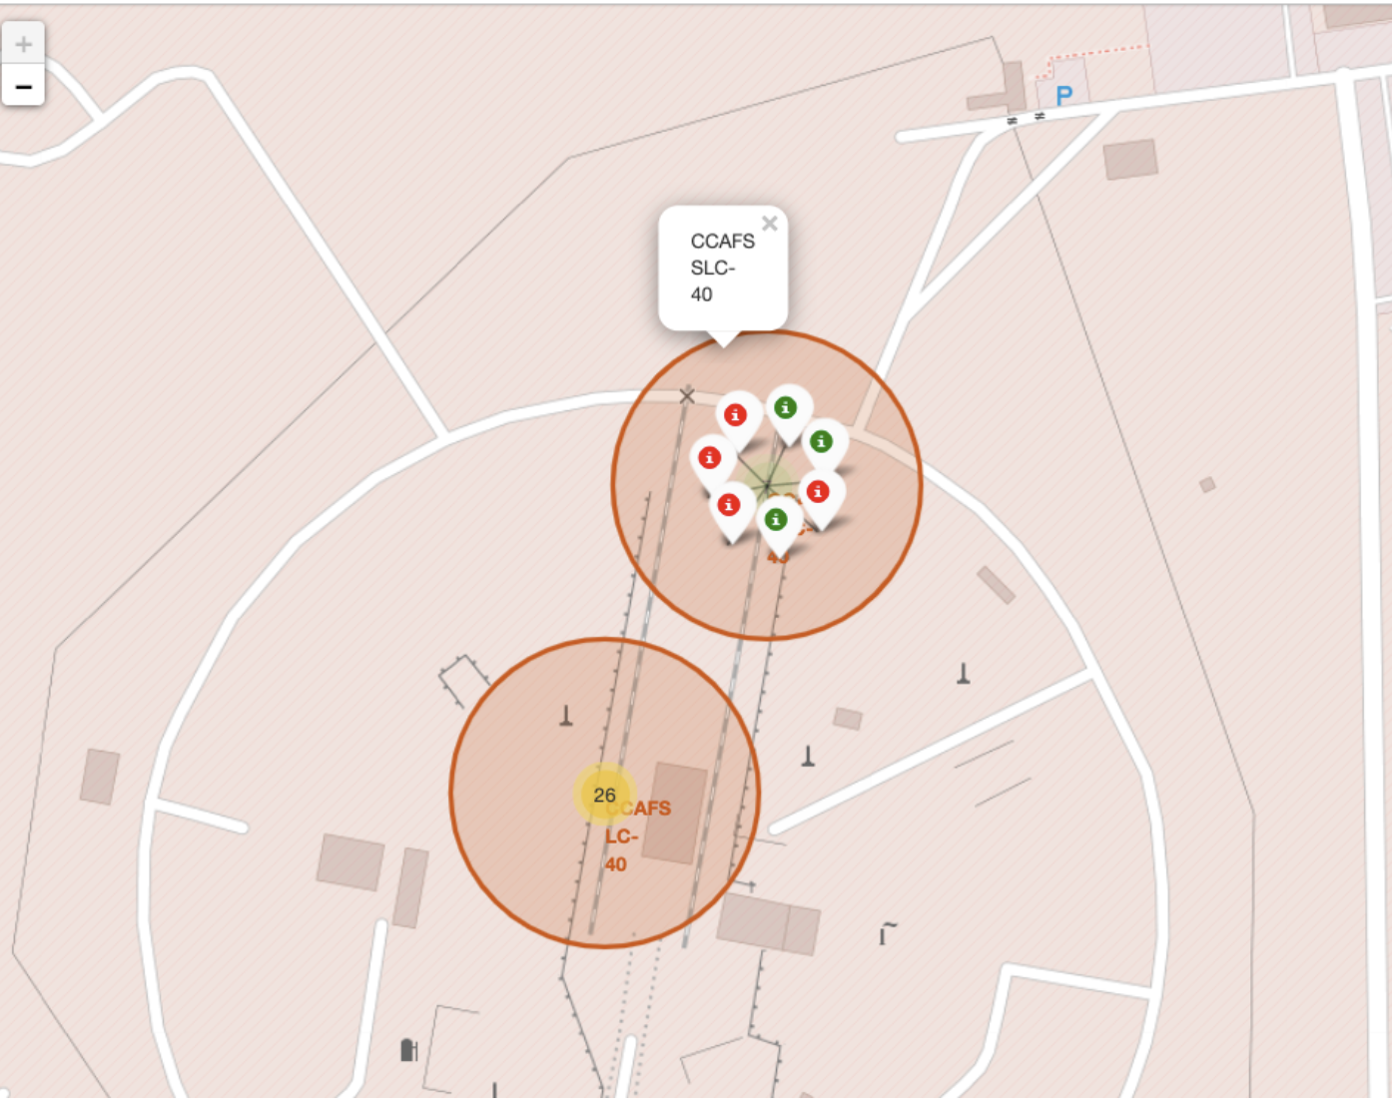
Success Rate of Two Launch Sites
In this plot, two different colors have been used to portray the success rates of two laun sites of SpaceX

Slide 37

ALL Launch Site distances to Different landmarks
Replace <Folium map screenshot 3> title with an appropriate title
Explore the generated folium map and show the screenshot of a selected launch site to its proximities such as railway, highway, coastline, with distance calculated and displayed
Explain the important elements and findings on the screenshot

Slide 38

Section 4

Slide 39

Pie chart displaying the success percentage achieved by each launch site

Slide 40

Pie chart displaying the Launch site with the highest launch success ratio

Slide 41

Scatter plot of Payload vs Launch Outcome for all sites, with different payload selected in the range slider

Slide 42

Section 5

Slide 43

Classification Accuracy
From the different classification models, highest accuracy is obtained from the DecisionTree model with accuracy rate 87.3%.

Slide 44

Confusion Matrix
The decision tree classifier's confusion matrix demonstrates that it is capable of differentiating between the various classes. False positives are the main issue. In other words, the classifier misclassified a failure landing as a successful one.

Slide 45

Conclusions
We can draw the following conclusion:
A launch site's success rate increases with the size of the flight quantity.
Beginning in 2013, the launch success rate will rise through 2020.
The success rate was highest for ES-L1, GEO, HEO, SSO, and VLEO orbits.
Of all the sites, KSC LC-39A had the most prosperous launches.
The most effective machine learning approach for this task is the decision tree classifier.

Slide 46


